Slide 1


Radical OpSec for Journalists
Information Security and Open Internet for All

Slide 2
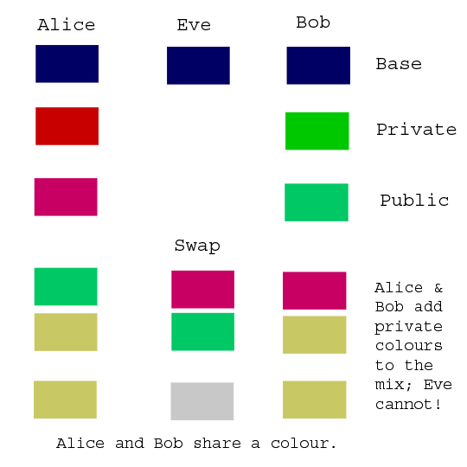
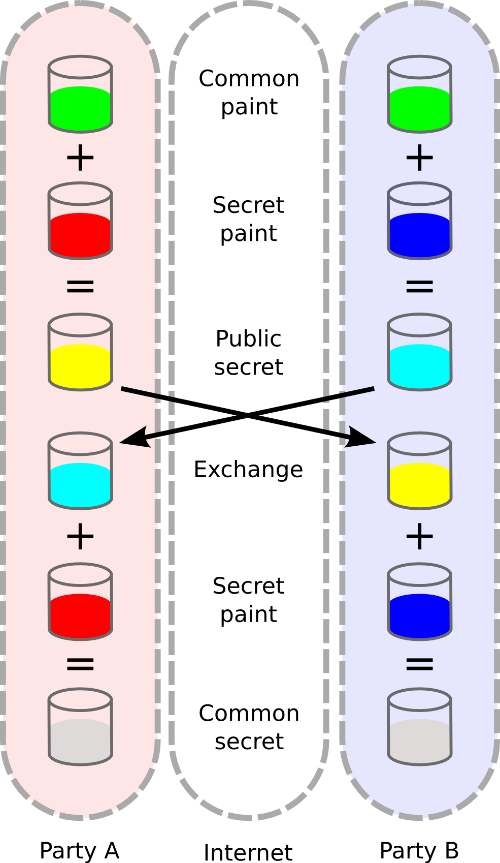
http://maths.straylight.co.uk/archives/108

Slide 3


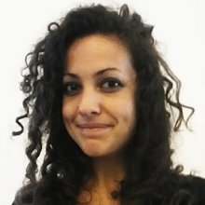




Harlo Holmes
NYTimes + Guardian Project
@harlo
Aurelia Moser
Ushahidi + Internews KE
@auremoser

Slide 4
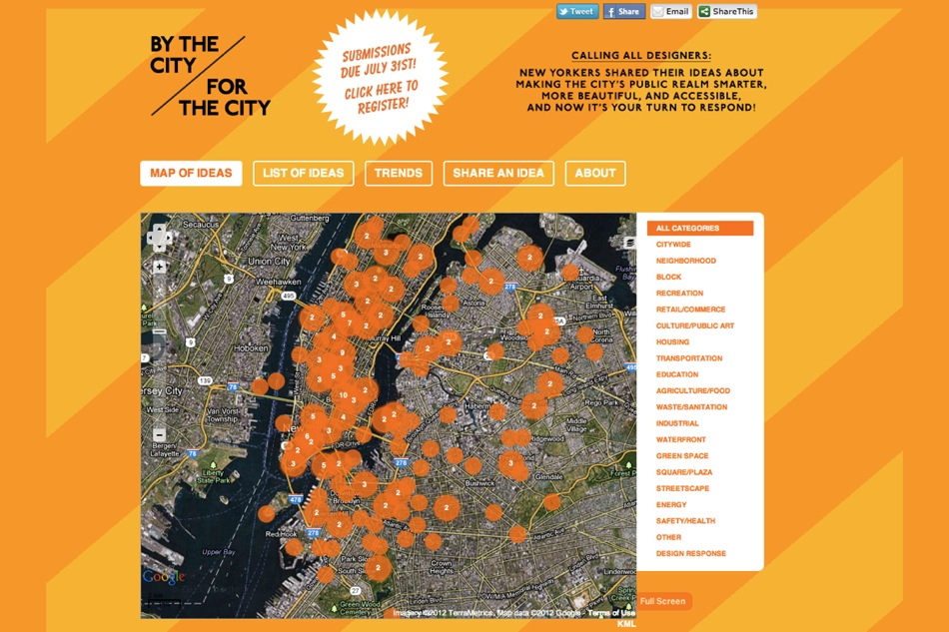
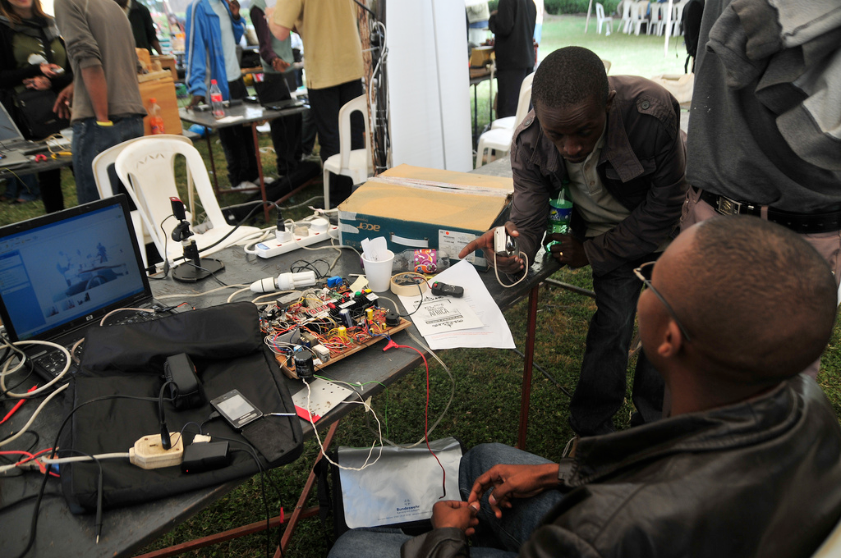
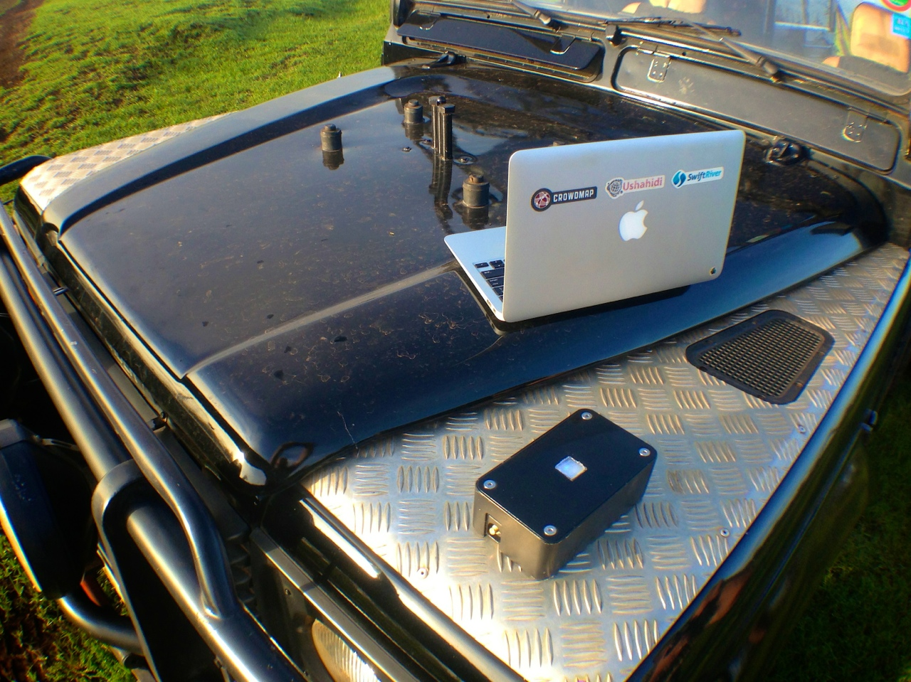

Slide 5
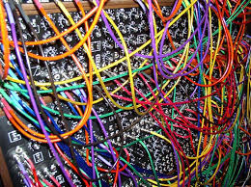
What + Why OpSec?
================

Slide 6
OpSec
======
Operational Security is behavioral and technological effort to protect personal and source privacy, security, and safety

Slide 7
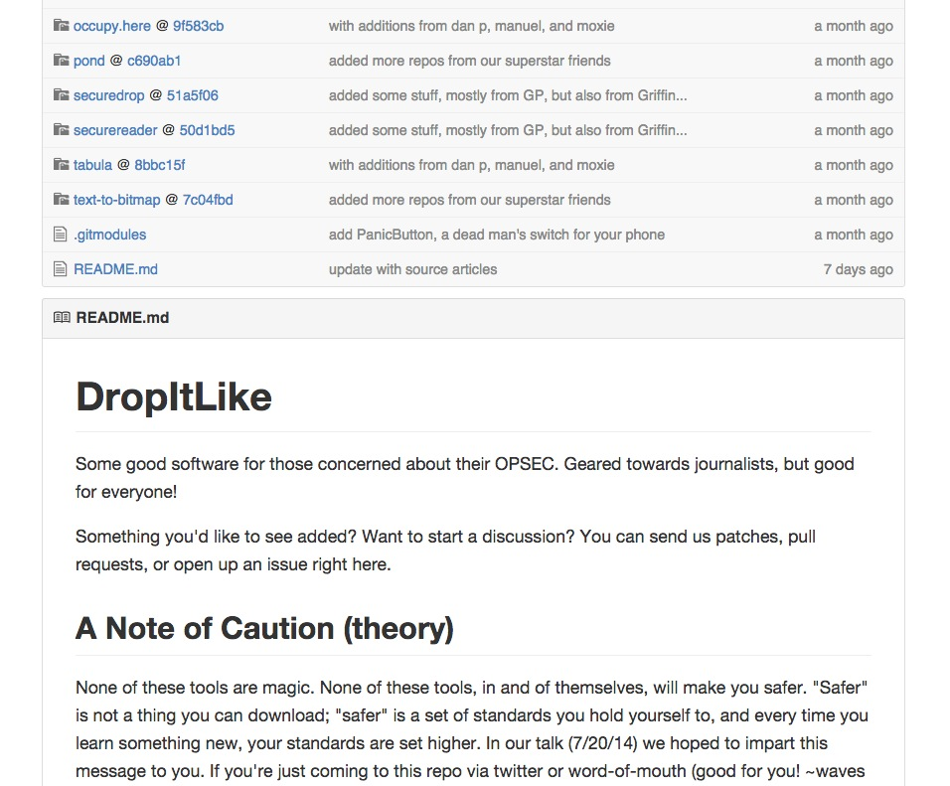
Notes:
Harlo: responsibilities involved with github software interaction

Slide 8
OPSEC Principles
Adopt a “burner mentality”
Use developer resources + tech (APK, Source)
Don’t talk about your work
Don’t trust rumors
Prepare for behavioral change
Notes:
Harlo: responsibilities involved with github software interaction

Slide 9
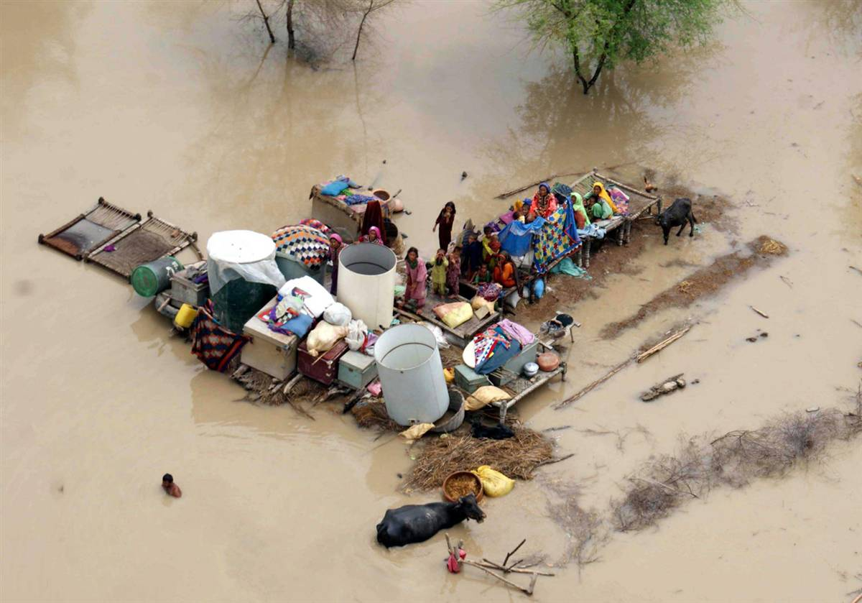
Pakistan 2010

Slide 10
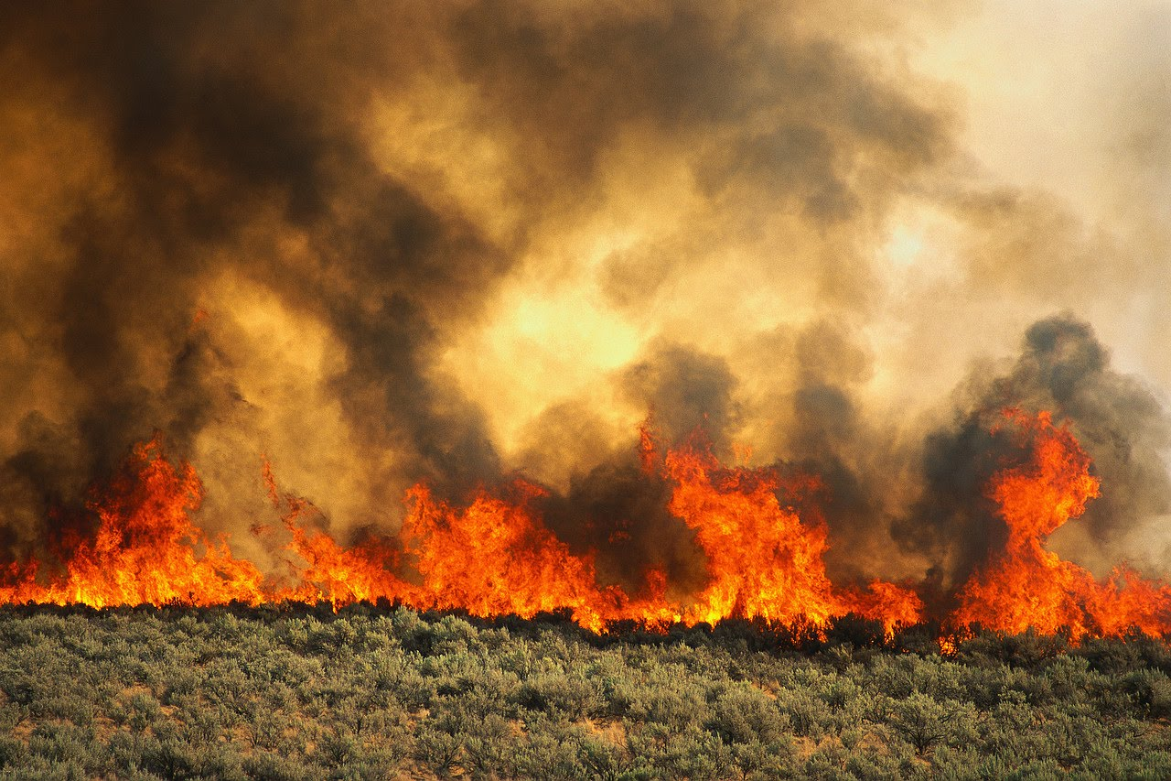
Russia 2010

Slide 11
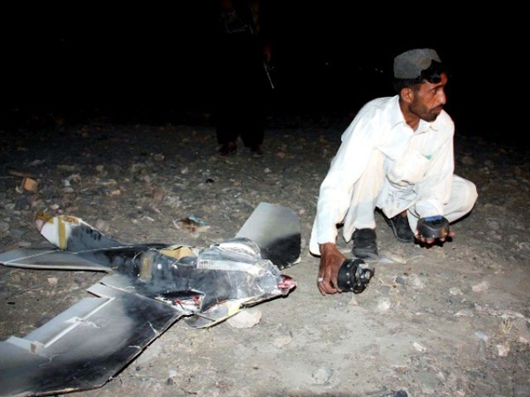
Pakistan 2011-12

Slide 12
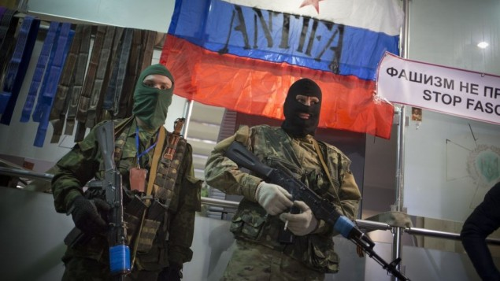
Russia 2014

Slide 13
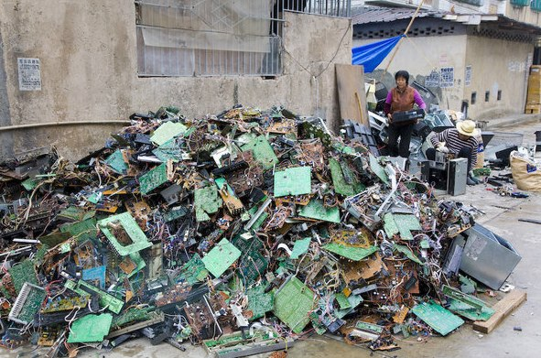
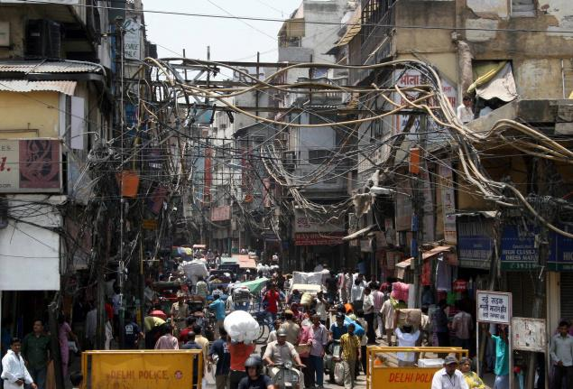
Challenging Infrastructure

Slide 14

Challenging Environments
UNRELIABLE POWER
UNRELIABLE CONNECTIVITY
HOSTILE ENVIRONMENT

Slide 15
Information security is as vulnerable to violation as physical security. Journalists straddle both vulnerabilities.

Slide 16

OpSec Risks
==========

Slide 17
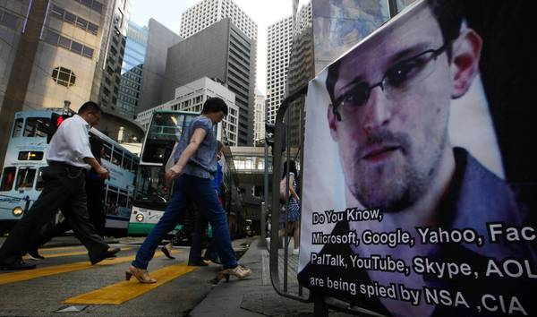

Slide 18
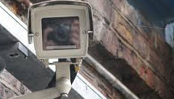
METADATA LEAKS
(Rosen + Petraeus)
THREATENED SECURITY
(Manning)
ACCIDENTAL DISCLOSURE
(McAfee)

Slide 19
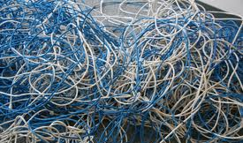
OpSec Tools
==========

Slide 20
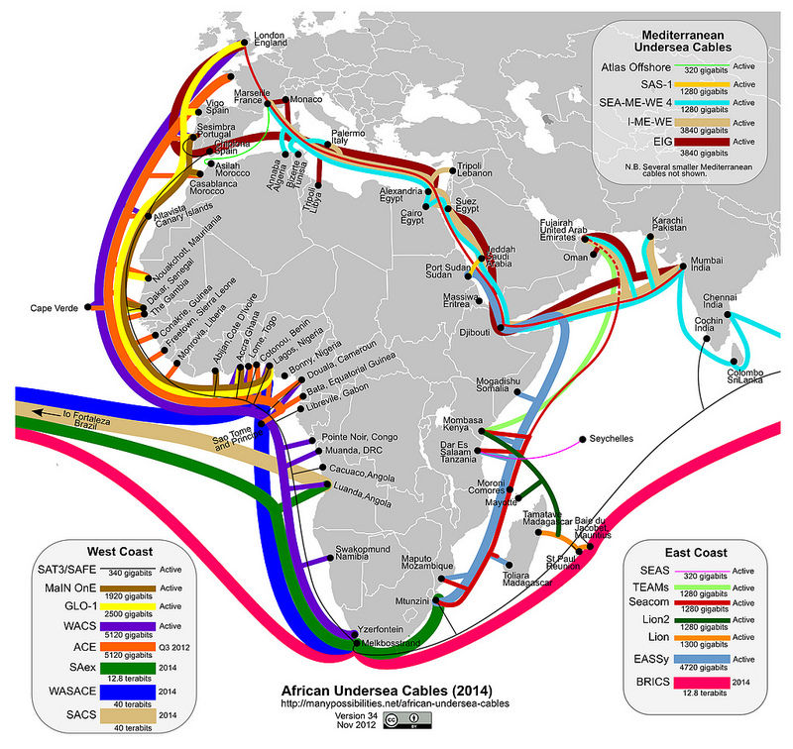
CONNECTIVITY
COMMUNICATION
METADATA SECURITY

Slide 21
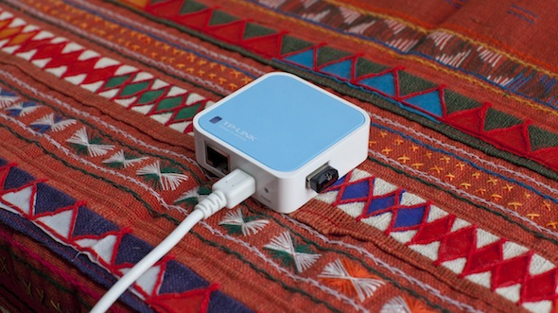
CONNECTIVITY
Occupy Here, Dan Phiffer, 2013

Slide 22

BRCK
FEATURES
WIFI Bridge + Client Modes
WPA/PSK, WEP Encryption
3G World Modem
BATTERY
8 hr battery (full) 8 day battery (sleep)
PORTS
Ethernet LAN/WAN Port
SIM Card Slot
USB Host Port
RP-SMA Antenna Connection : 3G/4G
LINKS
http://www.brck.com/specification
Cloud-managed, full-featured modern router with GSM cell failovers to get you connected
Notes:
Field and travel teams
Remote systems monitoring
Medium and small business networking
Support teams/schools
Personal networking

Slide 23


Pirate Box
PIRATE BOX
DIY anonymous offline file-sharing system
No logging or logins
http://piratebox.cc/
LIBRARY BOX
Open Source, portable, digital distribution tool
Fork of PirateBox for TP-Link MR 3020
For libraries, emergency responders
http://jasongriffey.net/librarybox/
OCCUPY HERE
Self-contained darknet, lan network for anon info sharing
http://occupyhere.org/
Pirate Box
Library Box
Occupy Here
Notes:
Field and travel teams
Remote systems monitoring
Medium and small business networking
Support teams/schools
Personal networking

Slide 24

Open Garden
OPEN GARDEN
Wireless mesh networking application
Data from Bluetooth, Wifi, 3/4G simultaneously
https://opengarden.com/
FIRECHAT
iOS/Android secure chat application
Group chat without internet
https://opengarden.com/firechat
FireChat
Notes:
Field and travel teams
Remote systems monitoring
Medium and small business networking
Support teams/schools
Personal networking

Slide 25

COMMUNICATION
Hot Probs, Sara Grant, 2013

Slide 26

Email/Text
Tanglr, Brian House, 2013

Slide 27
PGP
FEATURES
Cross platform
Allows for encrypting and decrypting by public key exchange
SETUP
Hook your email account to PGP software
Thunderbird + Enigmail
CAVEATS
Does not protect metatdata (to/from lines/subject line)
LINKS
http://www.pgpi.org/products/pgp/
http://www.openpgp.org/
https://pgp.mit.edu/
“Pretty Good Privacy” cryptographic privacy and authentication for data communication
Notes:
Field and travel teams
Remote systems monitoring
Medium and small business networking
Support teams/schools
Personal networking

Slide 28




Chat
LINKS
https://crypto.cat/
https://www.wickr.com/
https://bitmessage.org/wiki/Main_Page
https://telegram.org/
https://threema.ch/en
CryptoCat
Wickr
BitMessage/BitPost
Telegram
Threema
Notes:
Field and travel teams
Remote systems monitoring
Medium and small business networking
Support teams/schools
Personal networking

Slide 29

Text Secure
FEATURES
Android, soon iOS
Open Source
Private Group Chat
Fast
LINKS
https://whispersystems.org/
Easy, friendly private messaging app
Notes:
Field and travel teams
Remote systems monitoring
Medium and small business networking
Support teams/schools
Personal networking

Slide 30

Phone
Conversnitch, Brian House, 2014

Slide 31

Ostel
FEATURES
Works on every mobile device
Simple account registration
ZRTP & SRTP encryption
SIP signaling encyption
Video calls
LINKS
https://ostel.co/
https://github.com/guardianproject/OSTel
Public testbed of the OSTN project, to promote free open protocols for end-to-end secure voice communication on mobile
Notes:
Field and travel teams
Remote systems monitoring
Medium and small business networking
Support teams/schools
Personal networking

Slide 32


RedPhone + Signal
REDPHONE
Free and open source; Android application
End-to-end encryption for voice calls
Uses wifi/data not voice minutes
SIGNAL
iOS equivalent to RedPhone
LINKS
https://whispersystems.org/
Secure phone calls for free
Notes:
Field and travel teams
Remote systems monitoring
Medium and small business networking
Support teams/schools
Personal networking

Slide 33

Silent Circle
FEATURES
Low Cost subscription plans
Silent Call/Text
Peer-to-Peer platform of secure services on proprietary network
LINK
https://silentcircle.com/
Encrypted calling plans for private communication
Notes:
Field and travel teams
Remote systems monitoring
Medium and small business networking
Support teams/schools
Personal networking

Slide 34
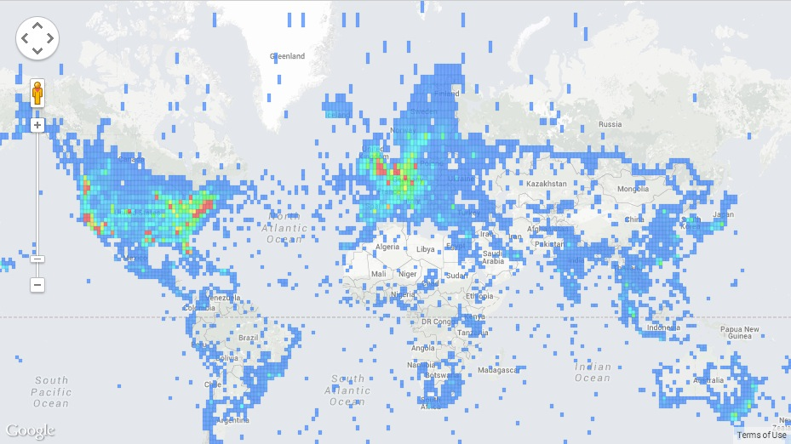
METADATA SECURITY
Open Paths, NYTLabs, 2011

Slide 35
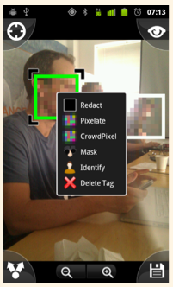
Camera
INFORMACAM
Mobile Application for Android
Allows for inflating images with metadata
Verified mobile metadata
https://github.com/guardianproject/InformaCore
OBSCURACAM
Obscures mobile image metadata
Pixelate/Redact faces
https://guardianproject.info/apps/obscuracam/
InformaCam
ObscuraCam
Notes:
Field and travel teams
Remote systems monitoring
Medium and small business networking
Support teams/schools
Personal networking

Slide 36
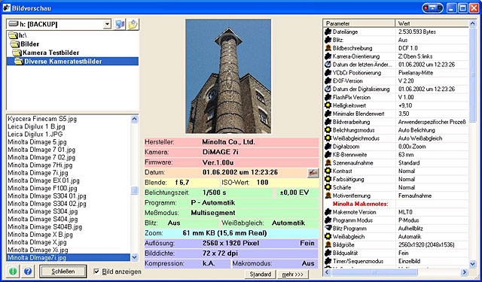
Metadata Schema
EXIF
Exchangeable image file format
Photo/sound metadata standard for cameras
IPTC
International Press Telecommunications Committee
Photoshop image metadata; builds on Adobe’s XMP image encoder
EXIF
IPTC
Notes:
Field and travel teams
Remote systems monitoring
Medium and small business networking
Support teams/schools
Personal networking

Slide 37

FDRIOD
FEATURES
Way to browse, intall, and track updates for android apps
LINK
https://f-droid.org/
Free and Open Source Android Application Repository
Notes:
Field and travel teams
Remote systems monitoring
Medium and small business networking
Support teams/schools
Personal networking

Slide 38
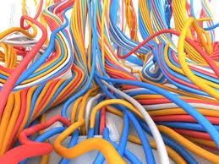
ART && CODE
===========

Slide 39
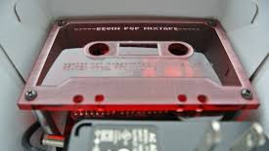
NSA Mixtape, David Huerta, 2014

Slide 40
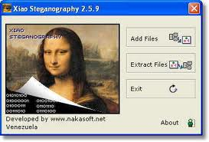
Art of Hiding
DEFINITION
the art of hiding signals in art/images
the art of hiding stylistic nuance in writing
EXAMPLES
https://code.google.com/p/f5-steganography/
GIFs
http://www.eberl.net/cgi-bin/stego.pl
https://www.npmjs.org/package/stegosaurus
Steganography
Stylometry
Notes:
Field and travel teams
Remote systems monitoring
Medium and small business networking
Support teams/schools
Personal networking

Slide 41


Art of Sharing
MINILOCK
Browser extension for encrypting files and sharing them
Built by the developer of Cryptocat
https://minilock.io/
KEYBASE.IO
Database of public keys connected to and verified by social media
Alternative trust network for storing information and internet identity to KeyServers
https://keybase.io/
MiniLock
KeyBase.io
Notes:
Field and travel teams
Remote systems monitoring
Medium and small business networking
Support teams/schools
Personal networking

Slide 42
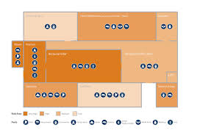
Art of Travel Privacy
FEATURES
Way of encrypting files locally, symmetrically
Keeping your assets safe when on the move or in a foreign local
LINK
https://github.com/harlo/hotel_safe
Hotel_Safe
Notes:
Field and travel teams
Remote systems monitoring
Medium and small business networking
Support teams/schools
Personal networking

Slide 43
Thank You!
Aurelia Moser
@auremoser
Harlo Holmes
@harlo

